Slide 1
Classification of Microstructural Image using a Transfer Learning Approach

Slide 2
Content
Introduction
Present work
Image Collection & dataset preparation
Network selection
Network customization
Transfer learning
Experimental results
Conclusions
References

Slide 3
Microstructure
Microstructure of metallic alloy is described by the grain size, type of phases, structure, shape etc.
The texture of dendrite microstructure is a tree like structure of crystal growing as molten metal solidifies.
The dendritic growth has large consequences on the mechanical properties and corrosion resistance of metallic alloys

Slide 4
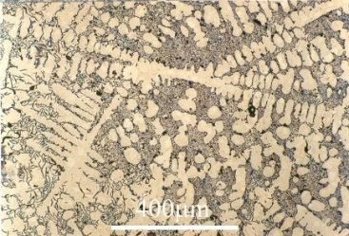
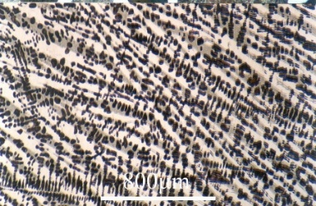
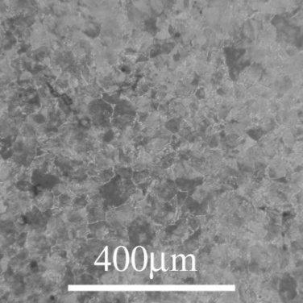
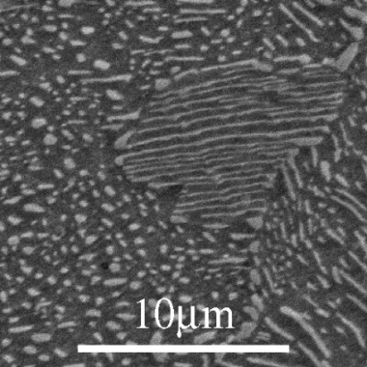
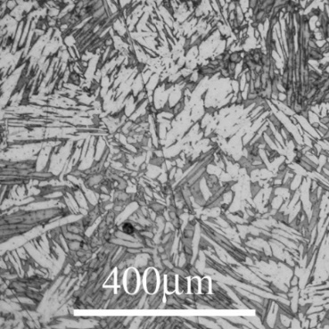
Micrograph
with dendrite
with dendrite
with dendrite
Cementite
(without dendrite)
Pearlite cementite
(without dendrite)
Widmanstätten cementite
(without dendrite)

Slide 5
Data Preparation
Images collected from ~
DoITPoMS micrograph library ( https://www.doitpoms.ac.uk/)
Ultra High Carbon Steel Micrograph DataBase ( http://uhcsdb.materials.cmu.edu/)
Classification of images ~
After cropping the original image of size 128x128 image are classified manually into 2 categories (With dendrite and without dendrite).

Slide 6
Overview of Present Technique
Deep Convolution Neural Network(DCNN)
Transfer Learning DCNN
Fine-tuning DCNN
Classifier selection

Slide 7
Pre-trained DCNN models used
DenseNet
MnasNet0_5
MnasNet1_0

Slide 8
Basic Diagram of our Present work
Fig. 1. Proposed Transfer learning based architecture used for classification of microstructure images.

Slide 9
Experimental Results
Fig. 3. Graphical plot of the classification accuracy of the respective models for various distribution of training and test datasets. (a) Densenet121 model, (b) MnasNet0_5 model; (c) MnasNet1_0 model

Slide 10
Experimental Results
Model | Image size | Train accuracy | Test accuracy | Class-wise precession
DenseNet121 | 224 x 224 | 96% | 95% | With dendrite. 100% Without dendritic. 94%
MnasNet0_5 | 224 x 224 | 92% | 93% | With dendrite. 96%, Without dendritic. 90%
MnasNet0_1 | 224 x 224 | 93% | 92% | With dendrite. 99% Without dendritic. 90%

Slide 11
Experimental Results (Cont.)
Models | Type | Class (Label) | Precision | Recall | F1-score
DenseNet121 | With-dendrite | 1.00 | 0.91 | 0.95 | 179
 | Without- dendritic | 0.91 | 1.00 | 0.95 | 169
 | Macro avg. | 0.96 | 0.96 | 0.95 | 348
 | Weighted avg. | 0.96 | 0.95 | 0.95 | 348
MnasNet0_5 | With-dendrite | 0.96 | 0.91 | 0.94 | 180
 | Without- dendritic | 0.91 | 0.96 | 0.94 | 168
 | Macro avg. | 0.94 | 0.94 | 0.94 | 348
MnasNet1_0 | Weighted avg. | 0.94 | 0.94 | 0.94 | 348
 | With-dendrite | 0.98 | 0.86 | 0.92 | 173
 | Without- dendritic | 0.88 | 0.98 | 0.93 | 175

Slide 12
Conclusion
Transfer learning based models offer a new way of recognizing microstructural image of interest.
The customized pre-trained DCNN can classify microstructure images with high degree of accuracy.
For future work, the model can be extended by incorporating the deep learning with attention network , better batch normalization and dropout techniques.

Slide 13
References
Goulart, P. R., W. R. Osório, J. E. Spinelli, and A. Garcia. "Dendritic microstructure affecting mechanical properties and corrosion resistance of an Al-9 wt% Si alloy." Materials and manufacturing processes 22, no. 3 (2007): 328-332.
Decost, Brian L., and Elizabeth A. Holm. “A Computer Vision Approach for Automated Analysis and Classification of Microstructural Image Data.” Computational Materials Science 110 (2015): 126–33.
Chowdhury, Aritra, Elizabeth Kautz, Bülent Yener, and Daniel Lewis. “Image Driven Machine Learning Methods for Microstructure Recognition.” Computational Materials Science 123 (2016): 176–87.
Liu, Ruoqian, Abhishek Kumar, Zhengzhang Chen, Ankit Agrawal, Veera Sundararaghavan, and Alok Choudhary. “A Predictive Machine Learning Approach for Microstructure Optimization and Materials Design.” Scientific Reports 5, no. 1 (2015).
Li, Xiong, et al.“DELTA: DEEP LEARNING TRANSFER USING FEATURE MAP WITH ATTENTION FOR CONVOLUTIONAL Networks (ICLR) 2019
Kitahara, Andrew R., and Elizabeth A. Holm. “Microstructure Cluster Analysis with Transfer Learning and Unsupervised Learning.” Integrating Materials and Manufacturing Innovation, vol. 7, no. 3, 2018, pp. 148–156.
Gu, Jiuxiang, Zhenhua Wang, Jason Kuen, Lianyang Ma, Amir Shahroudy, Bing Shuai, Ting Liu, et al. “Recent Advances in Convolutional Neural Networks.” Pattern Recognition 77 (2018): 354–77

Slide 14
References
Krizhevsky, Alex, et al. “ImageNet Classification with Deep Convolutional Neural Networks.” Communications of the ACM, vol. 60, no. 6, 2017, pp. 84–90.
Zeiler, Matthew D., and Rob Fergus. “Visualizing and Understanding Convolutional Networks.” Computer Vision – ECCV 2014 Lecture Notes in Computer Science, 2014, pp. 818–833.
K. Simonyan and A. Zisserman, “Very deep convolutional networks for large-scale image recognition” ICLR, vol. 75, no. 6, pp. 398–406, 2015.
Szegedy, Christian, Wei Liu, Yangqing Jia, Pierre Sermanet, Scott Reed, Dragomir Anguelov, Dumitru Erhan, Vincent Vanhoucke, and Andrew Rabinovich. “Going Deeper with Convolutions.” 2015 IEEE Conference on Computer Vision and Pattern Recognition (CVPR), 2015.
He, Kaiming, Xiangyu Zhang, Shaoqing Ren, and Jian Sun. “Deep Residual Learning for Image Recognition.” 2016 IEEE Conference on Computer Vision and Pattern Recognition
Weiss, Karl, et al. “A Survey of Transfer Learning.” Journal of Big Data, vol. 3, no. 1, 2016’
Pan, Sinno Jialin, and Qiang Yang. "A survey on transfer learning." IEEE Transactions on knowledge and data engineering 22, no. 10 (2009): 1345-1359.
Huang, Gao, et al. “Densely Connected Convolutional Networks.” 2017 IEEE Conference on Computer Vision and Pattern Recognition (CVPR), 2017.
Tan, Mingxing, et al. “MnasNet: Platform-Aware Neural Architecture Search for Mobile.” 2019 IEEE/CVF Conference on Computer Vision and Pattern Recognition (CVPR), 2019.

Slide 15
THANK YOU

